Slide 1
UNIT–3 Communication protocols for IoT
RS 232, RS 485
Ethernet, UART
USART, USB
Blue tooth, Zigbee
RFID
Application protocols: MQTT
CoAP, HTTP
Tutorial class

Slide 2
MQTT
(Message Queuing Telemetry Transport)
Lightweight and efficient protocol designed for IoT devices.
Follows a publish/subscribe model, making it ideal for real-time data communication.
Well-suited for low-power and resource-constrained devices.
Supports Quality of Service (QoS) levels to ensure message delivery reliability.
Widely used in various IoT applications, including home automation, smart cities, and industrial monitoring.

Slide 3
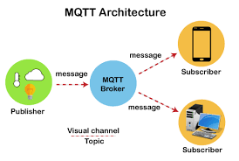

Slide 4
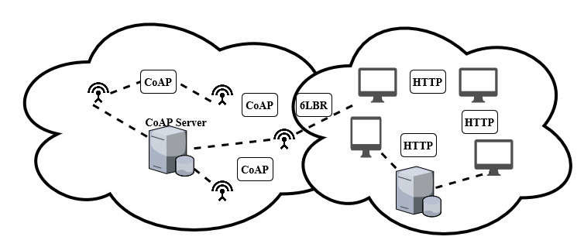
CoAP (Constrained Application Protocol)
CoAP (Constrained Application Protocol):
Designed for constrained IoT devices with limited processing power and memory.
Similar to HTTP/RESTful, enabling easy integration with web services.
Supports request/response interactions, making it suitable for device-server communication.
Efficient in terms of message size and processing overhead.
Often used in IoT applications like smart grids, healthcare monitoring, and connected vehicles.

Slide 5
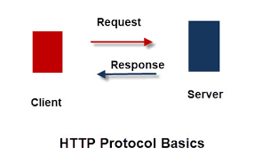
HTTP (Hypertext Transfer Protocol)
Well-established and widely used protocol in web
applications and IoT.
Supports both request/response and publish/subscribe models using WebSockets.
Utilized for cloud-based IoT architectures, allowing easy integration with web services.
Compatible with various platforms and programming languages.
Enables secure communication using HTTPS for data protection.

Slide 6
AMQP (Advanced Message Queuing Protocol)
Robust and reliable messaging protocol for IoT and enterprise applications.
Supports multiple communication patterns, including request/response and publish/subscribe.
Designed to handle large-scale deployments with high message throughput.
Ensures message integrity and delivery acknowledgment for critical applications.
Suitable for IoT solutions that require guaranteed message delivery and stringent quality control.

Slide 7
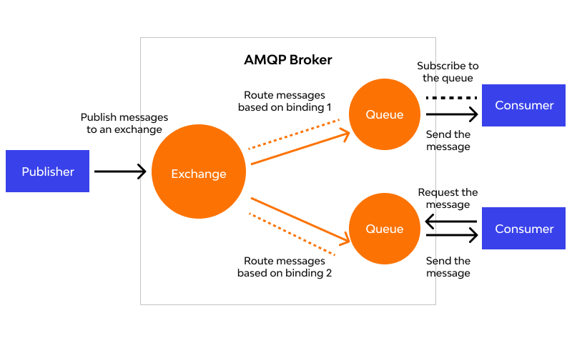
AMQP (Advanced Message Queuing Protocol)

Slide 8
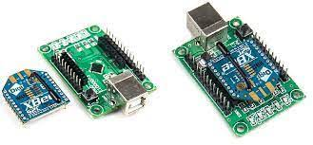
Zigbee
Low-power and short-range wireless protocol designed for home automation and industrial applications.
Supports mesh networking, enabling extended communication range and device interconnectivity.
Uses IEEE 802.15.4 standard for physical and MAC layer communication.
Provides low-latency and reliable data transfer, essential for real-time applications.
Often deployed in smart lighting systems, smart meters, and wireless sensor networks.

Slide 9
Features of Zigbee
Low Power Consumption:
Zigbee is optimized for energy efficiency, making it ideal for battery-operated devices with long battery life.
Mesh Networking:
Zigbee devices can create mesh networks, where each device acts as a node, allowing signals to hop from one device to another, extending the range and improving reliability.
Self-Healing:
The mesh network allows Zigbee to self-heal in case a device goes offline or is removed, ensuring continuous connectivity.
Interoperability:
Zigbee is an open standard, enabling devices from different manufacturers to work together seamlessly.
Secure Communication:
Zigbee incorporates security features like encryption and authentication, ensuring data privacy and protection against unauthorized access.

Slide 10
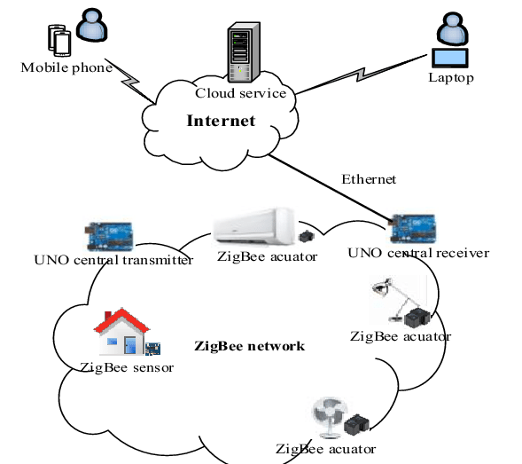

Slide 11
Applications of Zigbee
Home Automation:
Zigbee is used in smart home devices, such as smart bulbs, smart plugs, smart thermostats, and smart locks, allowing centralized control and automation.
Industrial Automation:
Zigbee enables wireless sensor networks for monitoring and control in industrial settings, improving efficiency and reducing maintenance costs.
Healthcare:
Zigbee is used in medical devices for remote patient monitoring and healthcare applications.
Smart Lighting:
Zigbee-based lighting systems offer advanced features like dimming, color control, and smart lighting scenes.
Smart Agriculture:
Zigbee is used in agricultural applications for monitoring soil conditions, temperature, and humidity, enhancing crop yield and efficiency.

Slide 12
Z wave
Wireless Communication Protocol:
Z-Wave is a wireless communication protocol designed for smart home applications and Internet of Things (IoT) devices.
It operates in the sub-GHz frequency range, which allows for better penetration through walls and obstacles, leading to improved signal reliability in indoor environments.
Mesh Networking:
Z-Wave devices form a mesh network, where each device acts as a signal repeater, relaying messages to extend the range and robustness of the network.
This mesh topology enhances the communication range and reliability, ensuring that messages reach their intended destinations even in large and complex smart home setups.

Slide 13
Low Power Consumption:
Z-Wave is optimized for low power consumption, making it
well-suited for battery-operated devices.
The protocol's efficient use of energy enables long battery life, reducing the need for frequent battery replacements in smart home devices like door/window sensors, motion detectors, and smart locks.
Interoperability and Certification:
To ensure interoperability and compatibility among various manufacturers' devices, Z-Wave Alliance, a consortium of companies, manages and certifies Z-Wave products.
Devices with the Z-Wave logo have undergone rigorous testing to meet the standard, ensuring seamless integration with other Z-Wave devices and systems.
Security and Encryption:
Z-Wave incorporates robust security features to protect smart home systems from unauthorized access and data breaches.
It uses AES 128-bit encryption for secure communication between devices, reducing the risk of data interception and tampering, providing peace of mind to users concerned about the privacy and security of their smart homes.

Slide 14
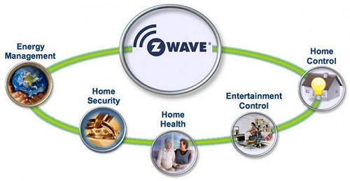

Slide 15
LoRaWAN
Long-Range Communication:
LoRaWAN (Long Range Wide Area Network) is designed to provide long-range communication capabilities for IoT devices.
It can achieve communication distances of several kilometers in open environments and several hundred meters in urban environments, making it ideal for wide-area IoT deployments.
Low Power Consumption:
One of the key strengths of LoRaWAN is its low power consumption. IoT devices using LoRaWAN can operate on battery power for an extended
period, often lasting several years, which is particularly useful for applications in remote or difficult-to-reach locations.
Suitable for Low Data Rates:
LoRaWAN is well-suited for applications that require low data rates but can tolerate longer transmission times.
It is ideal for sending small packets of data, such as sensor readings, at regular intervals.
.

Slide 16
Supports Scalability:
LoRaWAN supports a scalable network architecture, allowing for the deployment of a large number of devices without overloading the network.
It uses a star-of-stars topology, where end-devices communicate with gateway nodes that, in turn, forward the data to the central network server.
License-Free Spectrum:
LoRaWAN operates in the unlicensed ISM (Industrial, Scientific, and Medical) bands, making it accessible for public use in many regions worldwide.
The use of unlicensed spectrum reduces the complexity and cost of deploying LoRaWAN networks, making it an attractive option for IoT applications

Slide 17
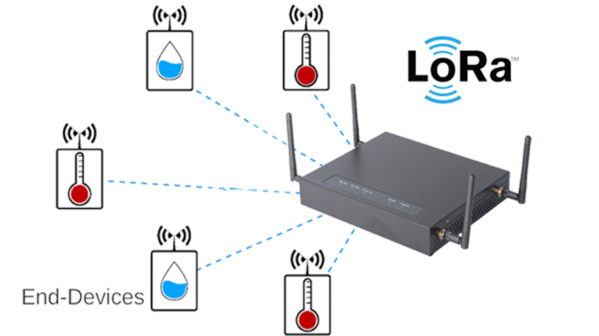

Slide 18
NB-IoT (Narrowband IoT)
Low Power Consumption:
NB-IoT is designed to operate with ultra-low power consumption, making it ideal for IoT devices that require long battery life.
This efficiency allows devices to operate for several years on a single battery, reducing maintenance and operational costs.
Wide Area Coverage:
NB-IoT is optimized for wide-area coverage, providing extended reach in comparison to traditional cellular networks.
It can penetrate through buildings and underground structures, making it suitable for applications in urban, rural, and remote areas.
Licensed Spectrum:
Unlike some other LPWAN (Low-Power Wide-Area Network) technologies that operate in unlicensed spectrum, NB-IoT uses licensed spectrum, which offers greater network security and reliability.
It operates alongside existing cellular networks, ensuring robust and interference-free communication.

Slide 19
Cost-Effective:
NB-IoT leverages existing cellular infrastructure, allowing for a
cost-effective deployment of IoT networks.
Cellular operators can upgrade their networks to support NB-IoT with a software update, reducing the need for significant infrastructure investments.
Support for Massive Device Connectivity:
NB-IoT is designed to handle a large number of connected devices simultaneously.
It supports massive device connectivity, making it suitable for applications with a high density of IoT devices, such as smart cities, industrial automation, and utility metering.

Slide 20
Sigfox
Low Data Rate and Long Range:
Sigfox is a Low-Power Wide Area Network (LPWAN) technology that operates at a very low data rate.
It can transmit small amounts of data over long distances, typically several kilometers, making it suitable for applications that require low-bandwidth, long-range communication.
Ultra-Low Power Consumption:
Sigfox is designed for ultra-low power consumption, enabling battery-operated devices to have a long operational life, often up to several years, without requiring frequent battery replacements.
This characteristic is advantageous for applications where power supply and maintenance are challenging.

Slide 21
Unlicensed Spectrum:
Sigfox uses the ISM (Industrial, Scientific, and Medical) radio frequency bands, which are unlicensed and available for public use in many regions. This allows for simple and cost-effective deployment without the need to acquire dedicated spectrum licenses.
Global Network Coverage:
Sigfox offers a global network coverage, with its network presence in multiple countries around the world.
This enables seamless and consistent connectivity for IoT devices in different regions, making it an attractive choice for international deployments.
Simplified Device and Network Architecture:
Sigfox's architecture is designed for simplicity, both in terms of device hardware and network infrastructure.
The lightweight protocol and straightforward communication flow simplify the development of IoT devices, reducing costs and time-to-market for IoT solutions.

Slide 22
RFID (Radio-Frequency Identification)
RFID is a wireless technology that uses radio-frequency signals to identify and track objects.
It consists of tags, readers, and a backend system for data management.
Tags contain unique identification data and can be passive, active, or semi-passive.
Passive Tags: Powered by the reader's signal, no internal power source.
Active Tags: Have their power source, enabling longer read ranges.
Semi-Passive Tags: Use an internal battery for some operations.

Slide 23
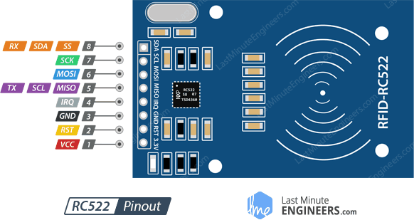
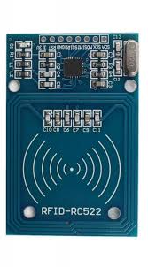

Slide 24
Reader sends an RF signal to the tag.
The tag's antenna captures the signal, powering the tag.
Tag responds with its unique ID or data to the reader.
Contactless and Non-line-of-sight: Tags can be read without direct visibility.
High Accuracy and Speed: Rapid identification and data capture.
Automation and Efficiency: Streamlines processes in supply chain and logistics.
Cost-effective: Reduces manual labor and human errors.

Slide 25
Applications
Inventory Management: Efficient tracking of products in warehouses.
Retail: RFID-enabled checkout, anti-theft systems.
Healthcare: Patient tracking, medical equipment management.
Access Control: Secure entry systems in buildings and events.
Logistics: Real-time shipment tracking and route optimization.
Cost: Implementation and integration expenses.
Interoperability: Ensuring compatibility between different RFID systems.
Privacy Concerns: Data protection and unauthorized tracking.
Internet of Things (IoT): RFID integration with IoT for seamless data exchange.
NFC (Near Field Communication): RFID-based contactless payments and smart devices.
RTLS (Real-Time Location Systems): Enhanced tracking and localization capabilities.
RFID technology revolutionizes various industries with efficient identification and tracking capabilities..

Slide 26
Protocol | Communication Type | Range of Operation | Network Type | Use Cases
MQTT | Publish/Subscribe | Short to Medium | Centralized | Home automation, Telemetry, IoT data streams
CoAP | Request/Response | Short to Medium | Centralized | Smart grids, Connected healthcare, Web of Things
AMQP | Message Queue | Short to Long | Centralized | Industrial automation, Reliable data exchange
Zigbee | Mesh Networking | Short | Mesh | Home automation, Smart lighting, Sensor networks
Z-Wave | Mesh Networking | Short | Mesh | Home automation, Smart locks, Energy monitoring

Slide 27
Protocol | Communication Type | Range of Operation | Network Type | Use Cases
LoRaWAN | Star-of-Stars | Long | Star-of-Stars | Smart agriculture, Asset tracking, Smart cities
NB-IoT | Cellular-based | Long | Star | Utility metering, Smart cities, Remote monitoring
Sigfox | Ultra-Narrowband | Long | Star | Smart utilities, Environmental monitoring, Asset tracking

Slide 28
APPLICATION OF COMMUNICATION PROTOCOLS
Communication Protocol | Best Applications
MQTT | Home automation, Telemetry, Industrial monitoring, Smart cities, Real-time data streams
CoAP | Smart grids, Connected healthcare, Environmental monitoring, Web of Things
AMQP | Industrial automation, Reliable data exchange, IoT data integration
Zigbee | Home automation, Smart lighting, Sensor networks, Wireless sensor nodes
Z-Wave | Home automation, Smart locks, Energy monitoring, Lighting control
LoRaWAN | Smart agriculture, Asset tracking, Smart cities, Remote monitoring, Environmental sensing
NB-IoT | Utility metering, Smart cities, Remote monitoring, Connected infrastructure
Sigfox | Smart utilities, Environmental monitoring, Asset tracking, Industrial IoT

Slide 29
Protocol | Communication Type | Use Cases
MQTT | Publish/Subscribe | Home automation, Telemetry, Industrial monitoring, Smart cities, Real-time data streams
CoAP | Request/Response | Smart grids, Connected healthcare, Environmental monitoring, Web of Things
HTTP | Request/Response | Cloud-based IoT architectures, Web service integration, Device management, Real-time data communication

Slide 30
Protocol | Advantages | Disadvantages
MQTT | Lightweight, Efficient, Real-time data communication, Suitable for low-power devices | Requires a central message broker, May not be suitable for request/response interactions in certain scenarios
CoAP | Designed for constrained devices, Similar to HTTP/RESTful, Supports request/response interactions | May have limited support compared to MQTT and HTTP, May not be as widely adopted in certain IoT ecosystems
HTTP | Well-established, Robust, Supports both request/response and publish/subscribe via WebSockets | Heavier compared to MQTT and CoAP, May not be as efficient for constrained devices and low-bandwidth networks

Slide 31
IoT communication protocols and features
Protocol | Features
MQTT (Message Queuing Telemetry Transport) | Lightweight, publish/subscribe model, ideal for low-power devices and constrained networks, efficient for real-time data communication.
CoAP (Constrained Application Protocol) | Designed for constrained devices and low-power networks, similar to HTTP/RESTful, supports request/response interactions.
HTTP (Hypertext Transfer Protocol) | Widely used, well-established, supports both request/response and publish/subscribe models using WebSockets for real-time data.
AMQP (Advanced Message Queuing Protocol) | Robust and reliable messaging protocol, supports multiple communication patterns like request/response, publish/subscribe, and more.
Zigbee | Low-power, short-range wireless protocol, ideal for home automation and industrial applications, supports mesh networking.

Slide 32
Z-Wave | Low-power, short-range wireless protocol, primarily used for home automation, supports mesh networking, designed for reliability.
LoRaWAN | Long-range, low-power protocol, suitable for wide-area IoT deployments, supports battery-operated devices, ideal for outdoor use.
NB-IoT (Narrowband IoT) | Cellular-based protocol, designed for low-power, wide-area IoT applications, operates in licensed spectrum for better security.
Sigfox | Low-power, wide-area protocol, ideal for simple applications with low data transmission requirements, operates in unlicensed spectrum.
Bluetooth | Short-range wireless protocol, suitable for connecting devices in close proximity, supports low-energy communication for IoT devices.

Slide 33
comparison between communication protocols
MQTT vs. CoAP:
MQTT is ideal for real-time data communication, supporting a publish/subscribe model.
It is suitable for low-power and constrained devices, making it prevalent in smart home applications.
CoAP is designed for constrained devices and follows a request/response model. It is suitable for resource-constrained IoT devices that need to communicate with web services.
CoAP is often used in applications like smart grids and connected healthcare.
MQTT vs. HTTP:
MQTT is more lightweight and efficient, making it preferable for low-power and constrained devices.
It is widely used for real-time data communication in various IoT applications.
HTTP is well-established and offers robustness and flexibility.
It supports both request/response and publish/subscribe models using WebSockets, making it suitable for cloud-based IoT architectures and web service integration.

Slide 34
AMQP vs. MQTT:
AMQP is a more robust and reliable messaging protocol,
suitable for large-scale IoT deployments and applications that require guaranteed message delivery.
It supports multiple communication patterns.
MQTT is lighter and simpler, making it better suited for low-power devices and applications where real-time communication is essential. It is widely used in home automation, telemetry, and sensor data collection.
Zigbee vs. Z-Wave:
Zigbee and Z-Wave are both low-power, short-range protocols used primarily in home automation and smart home applications.
Zigbee supports mesh networking and operates in the 2.4 GHz band, while Z-Wave also supports mesh networking but operates in the sub-GHz band.
The choice between the two often depends on regional frequency regulations and device compatibility.

Slide 35
LoRaWAN vs. NB-IoT vs. Sigfox:
LoRaWAN offers long-range communication and low power consumption, making it suitable for wide-area deployments and outdoor applications.
NB-IoT operates in licensed cellular spectrum, providing better security and reliability, making it suitable for large-scale deployments and applications that require guaranteed connectivity.
Sigfox operates in unlicensed spectrum and provides global coverage, making it cost-effective and straightforward for international IoT deployments with small data payloads.

Slide 36
Protocol | Communication Type | Range | Power Consumption | Network Topology | Spectrum | Security | Use Cases
MQTT | Publish/Subscribe | Short to Medium | Low | Centralized | N/A (IP-based) | Secure (with SSL/TLS) | Home automation, Telemetry, IoT data streams
CoAP | Request/Response | Short to Medium | Low | Centralized | N/A (IP-based) | Secure (with DTLS) | Smart grids, Connected healthcare, Web of Things
AMQP | Message Queue | Short to Long | Medium | Centralized | N/A (IP-based) | Secure (TLS) | Industrial automation, Reliable data exchange

Slide 37
Protocol | Communication Type | Range | Power Consumption | Network Topology | Spectrum | Security | Use Cases
Zigbee | Mesh Networking | Short | Low | Mesh | 2.4 GHz | Secure (AES-128) | Home automation, Smart lighting, Sensor networks
Z-Wave | Mesh Networking | Short | Ultra-Low | Mesh | Sub-GHz | Secure (AES-128) | Home automation, Smart locks, Energy monitoring
LoRaWAN | Star-of-Stars | Long | Ultra-Low | Star-of-Stars | Sub-GHz | Secure (AES-128) | Smart agriculture, Asset tracking, Smart cities

Slide 38
Protocol | Communication Type | Range | Power Consumption | Network Topology | Spectrum | Security | Use Cases
NB-IoT | Cellular-based | Long | Low | Star | Licensed | Secure (3GPP security) | Utility metering, Smart cities, Remote monitoring
Sigfox | Ultra-Narrowband | Long | Ultra-Low | Star | Unlicensed | Secure (custom MAC) | Smart utilities, Environmental monitoring, Asset tracking

Slide 39
Communication Protocol | Best Applications
MQTT | Home automation, Telemetry, Industrial monitoring, Smart cities, Real-time data streams
CoAP | Smart grids, Connected healthcare, Environmental monitoring, Web of Things
AMQP | Industrial automation, Reliable data exchange, IoT data integration
Zigbee | Home automation, Smart lighting, Sensor networks, Wireless sensor nodes
Z-Wave | Home automation, Smart locks, Energy monitoring, Lighting control
LoRaWAN | Smart agriculture, Asset tracking, Smart cities, Remote monitoring, Environmental sensing
NB-IoT | Utility metering, Smart cities, Remote monitoring, Connected infrastructure
Sigfox | Smart utilities, Environmental monitoring, Asset tracking, Industrial IoT

Slide 41
Bluetooth
Bluetooth is a wireless communication technology that enables short-range data exchange between electronic devices.
Named after the 10th-century Danish king, Harald Bluetooth, who united Scandinavia, symbolizing the technology's unifying capabilities.
First developed in the 1990s, Bluetooth has since become an integral part of modern devices and is widely used in smartphones, laptops, headphones, speakers, and more.

Slide 42
Features of Bluetooth
Wireless Connectivity:
Bluetooth eliminates the need for physical cables, allowing devices to communicate seamlessly within a short range (typically up to 10 meters).
Low Power Consumption:
Bluetooth uses low power, making it energy-efficient and ideal for battery-powered devices, ensuring extended battery life.
Pairing and Connection:
Devices establish a secure connection through a process called "pairing," ensuring data privacy and preventing unauthorized access.
.

Slide 43
Profiles:
Bluetooth devices support various profiles (e.g., Hands-Free, A2DP, HID), each defining specific functionalities for different use cases.
Compatibility:
Bluetooth is backward compatible, meaning newer versions can communicate with older ones, maintaining interoperability across devices

Slide 44
Applications of Bluetooth
Hands-Free Calling: Bluetooth-enabled car systems and headsets allow for safe and hands-free communication while driving.
Audio Streaming: Wireless headphones, speakers, and earbuds offer a tangle-free audio experience.
Smart Home: Bluetooth connects smart devices like lights, thermostats, and locks, enabling centralized control through smart phones or smart speakers.
Fitness and Health: Fitness trackers and heart rate monitors use Bluetooth to sync data with smart phones and health apps.
IoT Connectivity: Bluetooth plays a crucial role in connecting Internet of Things (IoT) devices for home automation and industrial applications.
File Transfer: Bluetooth facilitates quick and simple file sharing between smart phones and computers.

